Slide 1
FINAL PROJECT
EMPLOYEE ATTRITION
BY PHOEBE NABUNYA

Slide 2
Machine Learning Goal
Machine Learning Goal for the dataset
To predict the likelihood that an employee is at risk of leaving the company to enable the implementation of proactive retention strategies.
Background
The provided data is the HR information of a company including the Employee Information and Performance rating
16.1% is the attrition rate, 1470 total employees

Slide 3
Dataset description
Employee dataset: This dataset contains the primary profile and demographic information for each staff member. (Rows: 1470, Columns: 23)
Performance rating: This dataset contains historical performance reviews and satisfaction metrics recorded over time. (Rows: 6709, Columns: 13)
Education dataset: (Rows: 5, Columns: 2)
Datasource: https://app.datacamp.com/learn/courses/case-study-hr-analytics-in-tableau

Slide 4
Data Dictionary: Employee Data
Feature Name | Data Type | Description | Example-value
EmployeeID | String | Unique identifier for each employee. | 3012-1A41
FirstName | String | The employee's first name. | Leonelle
LastName | String | The employee's last name. | Simco
Gender | String | Gender identity of the employee. | Female, Male, Non-Binary or Prefer Not to Say
Age | Integer | The age of the employee. | 30
BusinessTravel | String | Frequency of business travel. | No Travel, Some Travel, Frequent Travel
Department | String | The department where the employee works | Sales, Technology, HR
DistanceFromHome (KM) | Integer | The distance between the employee’s home and the office in kilometers. | 20
State | String | The code of the US state where the employee is based. | NY, IL, CA
Ethnicity | String | The ethnic background of the employee. | White, Native Hawaiian
Education | Integer | Numeric code representing education level. | 1,2,3,4,5
EducationField | String | The primary field of study | Computer, Marketing
JobRole | String | The employee's specific job title | Software Engineer, Sales Executive
MaritalStatus | String | Current marital status | Single, Married, Divorced
Salary | Integer | The annual gross salary of the employee in USD . | 102059
StockOptionLevel | Integer | The level of stock options granted to the employee | 0 to 3
OverTime | String | Whether the employee works overtime | Yes/ No
HireDate | Date | The date the employee was hired. | 15/01/2012
Attrition | String | Whether the employee has left the company | Yes/ No
YearsAtCompany | Integer | Total years the employee has worked at the company. | 10
YearsInMostRecentRole | Integer | Number of years the employee has been in their current position. | 5
YearsSinceLastPromotion | Integer | Number of years since the employee was last promoted. | 4
YearsWithCurrManager | Integer | Number of years the employee has worked under their current manager. | 5

Slide 5
Data Dictionary: Performance rating
Feature Name | Data Type | Description | Example-value
PerformanceID | String | Unique identifier for each specific review record. | 79F7-78EC
EmployeeID | String | Unique identifier of the employee | 3012-1A41
ReviewDate | Date | The date the performance review was conducted. | 15/01/2012
EnvironmentSatisfaction | String | Rating of the physical work environment . | Satisfied, Dissatisfied, Very Satisfied, Very Dissatisfied
JobSatisfaction | String | Level of satisfaction with the current job role. | Satisfied, Dissatisfied, Very Satisfied, Very Dissatisfied
RelationshipSatisfaction | String | Level of satisfaction with workplace relationships/colleagues. | Satisfied, Dissatisfied, Very Satisfied, Very Dissatisfied
TrainingOpportunitiesWithinYear | Integer | Number of training sessions offered to the employee in the last year. | 1,2,3
TrainingOpportunitiesTaken | Integer | Number of training sessions the employee actually attended. | 0,1,2,3
WorkLifeBalance | String | Rating of the employee's balance between work and personal life. | Satisfied, Dissatisfied, Very Satisfied, Very Dissatisfied
SelfRatingID | Integer | Numeric ID associated with the employee's self-assessment. | 3,4,5
SelfRating | String | The text description of the self-rating | Above and beyond, Exceeds Expectation, Meets expectation
ManagerRatingID | Integer | Numeric ID associated with the manager's assessment. | 2,3,4,5
ManagerRating | String | The text description of the manager's rating. | Above and beyond, Exceeds Expectation, Meets expectation, Need improvement

Slide 6
Data Dictionary: Education Level
Feature Name | Data Type | Description | Example-value
EducationLevelID | Integer | Education numeric code (1–5) used in the Employee table. | 1–5
EducationLevel | String | The formal qualification name | Bachelors, Masters, Doctorate

Slide 7
Description of data
Employee data
 | Age | Distance From Home (KM) | Salary (USD) | Stock Option Level | Years At Company | Years In Most Recent Role | Years Since Last Promotion | Years With Current Manager
Count | 1470 | 1470 | 1470 | 1470 | 1470 | 1470 | 1470 | 1470
Mean | 28.989796 | 22.502721 | 112956.498 | 0.793878 | 4.562585 | 2.293197 | 3.440816 | 2.239456
Standard deviation | 7.993055 | 12.811124 | 103342.8892 | 0.852077 | 3.288048 | 2.539093 | 2.945194 | 2.505774
Min | 18 | 1 | 20387 | 0 | 0 | 0 | 0 | 0
25% | 23 | 12 | 43580.5 | 0 | 2 | 0 | 1 | 0
50% | 26 | 22 | 71199.5 | 1 | 4 | 1 | 3 | 1
75% | 34 | 33 | 142055.75 | 1 | 7 | 4 | 6 | 4
Max | 51 | 45 | 547204 | 3 | 10 | 10 | 10 | 10
Performance rating
 | Training Opportunities Within Year | Training Opportunities Taken | Self Rating ID | Manager Rating ID
Count | 6709 | 6709 | 6709 | 6709
Mean | 2.012968 | 1.01729 | 3.984051 | 3.473394
Standard deviation | 0.82031 | 0.950316 | 0.816432 | 0.961738
Min | 1 | 0 | 3 | 2
25% | 1 | 0 | 3 | 3
50% | 2 | 1 | 4 | 3
75% | 3 | 2 | 5 | 4
Max | 3 | 3 | 5 | 5

Slide 8
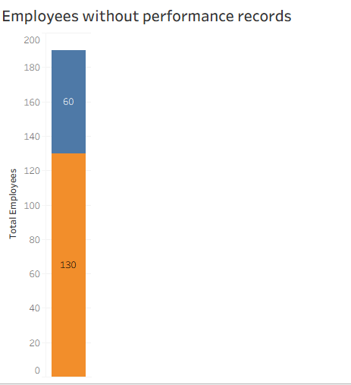

The dataset has 1470 total staff members; 1231 current employees (Attrition: No) and 237 employees (Attrition Yes) have left the organisation.
The current attrition rate is 16.1%
190 employees hired between 2021 and 2022 have missing performance records
Outlier - One Sales Executive is in the Technology Department - Sales Executive in Technology is presumed to be a Business Relationship Manager

Slide 9
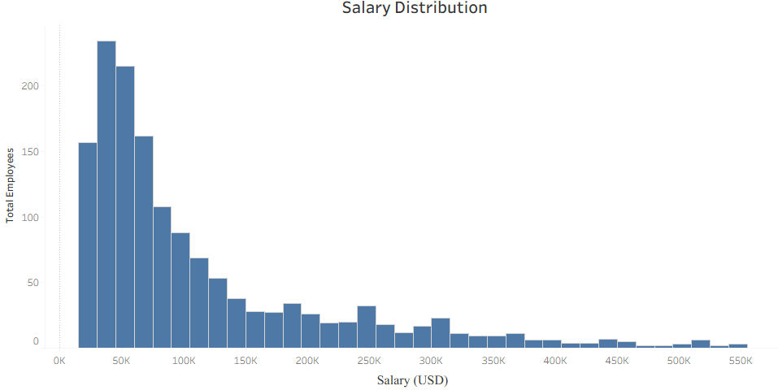
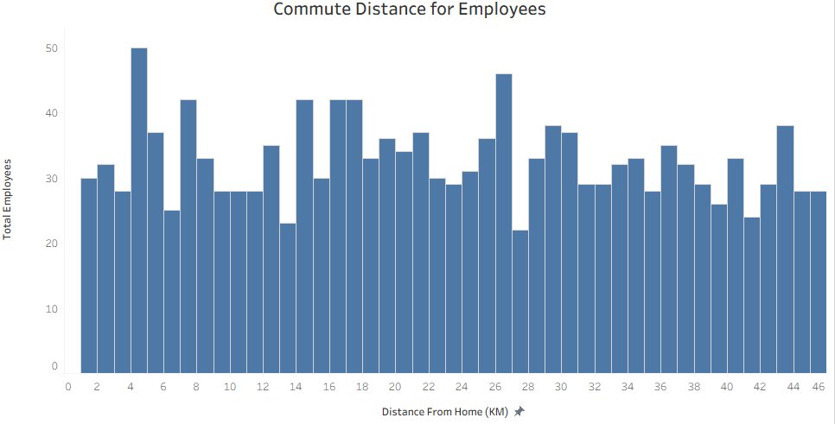
Distribution of Employee Salaries
Approximately 50% of the staff earn between USD 50,000 and USD 140,000
There is a significant number of employees who are paid higher than the median point: USD 75,000
Employee Commute
50% of the employees live closer than 22km and 50% leave further but not more than 42km

Slide 10
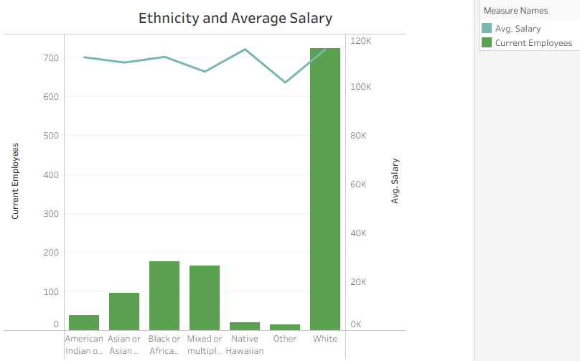
White is the largest ethnicity and highest paid
Other is the least paid ethnicity
Notes:
The large number of employees between the highest paid and least paid might affect average salary

Slide 11
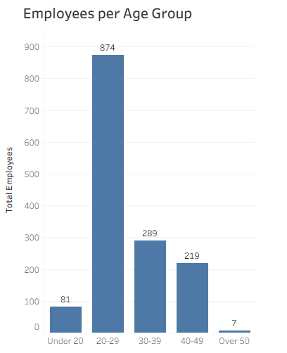
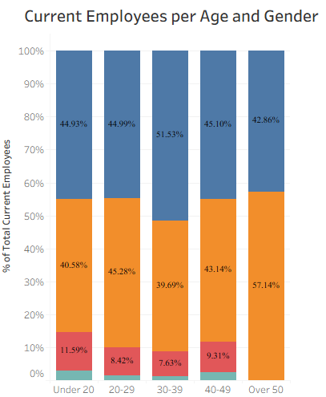
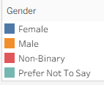
59% of the employees are between 20-29 years
Equal distribution male and female employees, and a lower percentage of non-binary

Slide 12
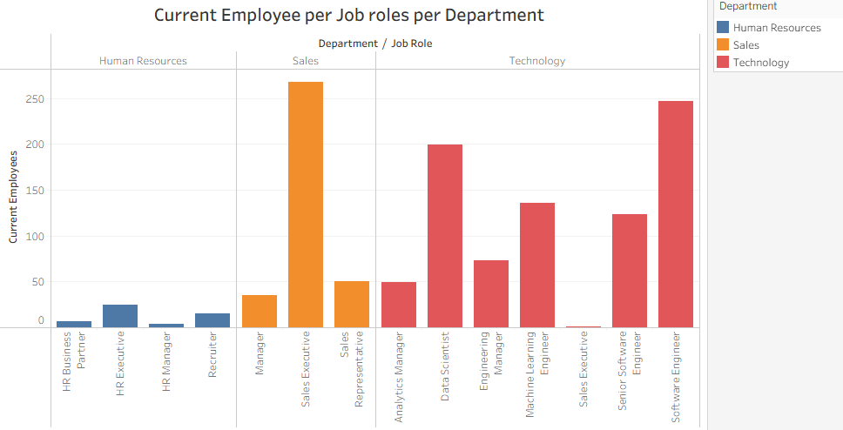
DEPARTMENTS
Technology department and Sales Executive roles have the largest number of staff
Sales Executive in Technology is presumed to be a Business Relationship Manager

Slide 13
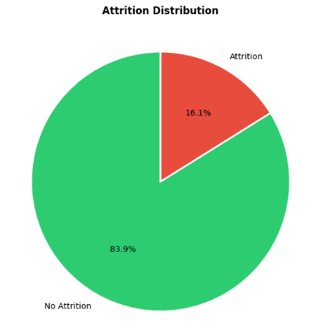
Attrition distribution
1468 unique employees
No Attrition: 1231 employees
Yes Attrition: 237 employees

Slide 14
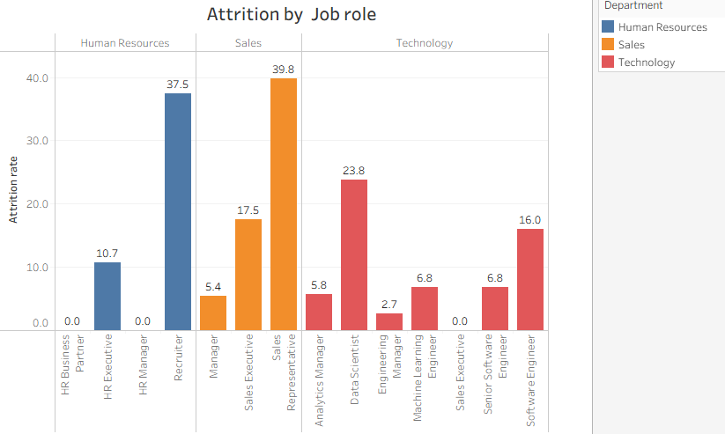
Attrition per Department per Job role
Sales Representatives have the highest number of attrition followed by the Recruiters.

Slide 15
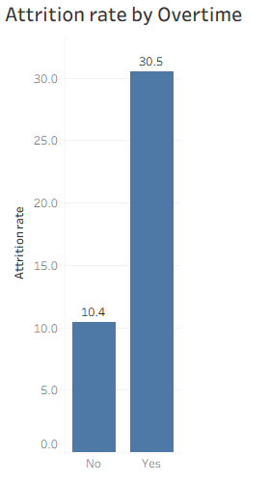
Attrition by Overtime
There is a high attrition rate for employees who work overtime
30.5% of the employees who work overtime left the organisation
Overall, 53.6% of the employees who left worked overtime

Slide 16
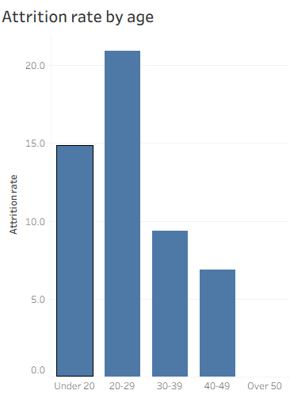
Highest Attrition rate for the range: 20-29

Slide 17
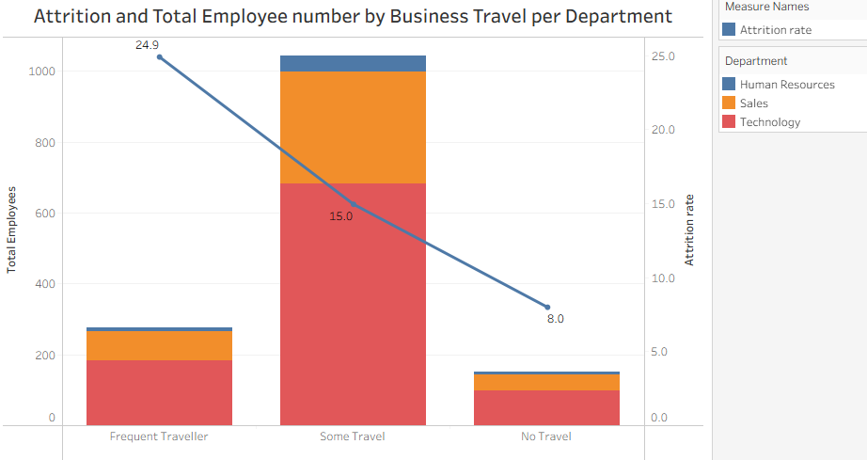
Employees in the Technology section are the most travellers
High attrition rate for frequent travellers

Slide 18
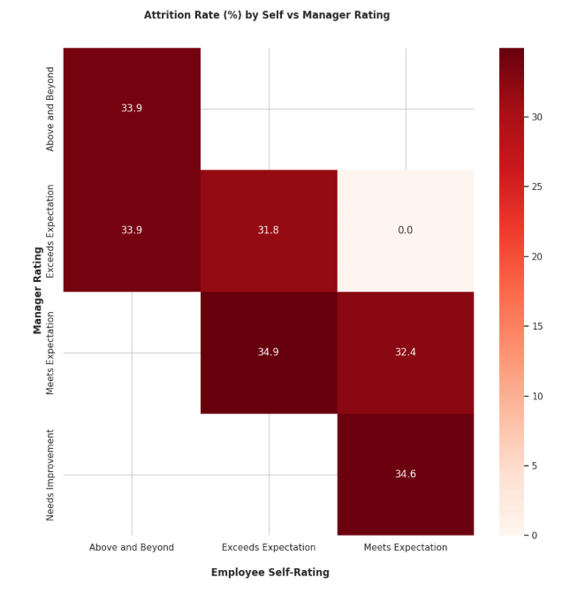
High rate of attrition when the manager rating is lower than the employee self rating
Those recognised by managers as high performers also have a high rate of attrition
1 Employee who got a higher rating from their managers have 0%

Slide 19
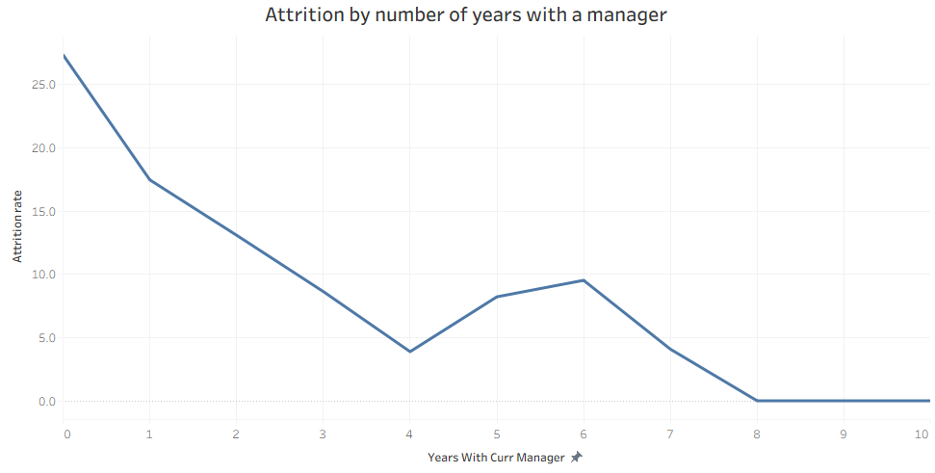
The likelihood of attrition reduces with the number of years a staff member spends with the Manager

Slide 20
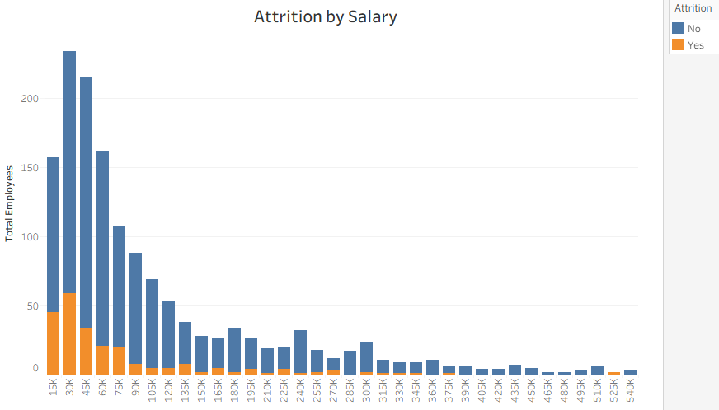
High attrition rate for employees in the lower salary bracket

Slide 21
Machine Learning models
Objective:
To predict employees that are at risk of leaving and apply appropriate retention measures.
Methodology:
In order to solve this problem, classification model was utilised.
The target feature/ variable was the Attrition
190 employees with missing performance records were dropped and only latest review records were considered

Slide 22
Evaluation Metrics
The cleaned data set is imbalanced with 18.5% attrition rate
The primary metrics for this data set is F1 score and ROC-AUC
Performance of Classical ML and Neural Network models
MODEL | Accuracy (%) | F1 Score | ROC-AUC
Logistic Regression | 0.8477 | 0.5618 | 0.8492
Random Forest | 0.8984 | 0.6977 | 0.9072
Gradient Boosting | 0.9062 | 0.7143 | 0.8776
Neural Network | 0.8594 | 0.6136 | 0.8777
Notes:
The percentage of staff who have left the organisation in the current dataset is 18.5%. The F1 score will help us to measure (Quality )of all instances the model predicted as yes, how many were actually yes and quantity of all yes instances how many did the model successful find.
The ROC-(Receiver Operating Characteristic) and AUC – (Area Under the Curve) - Probability that a random 'Yes' scores higher than a random 'No'.

Slide 23
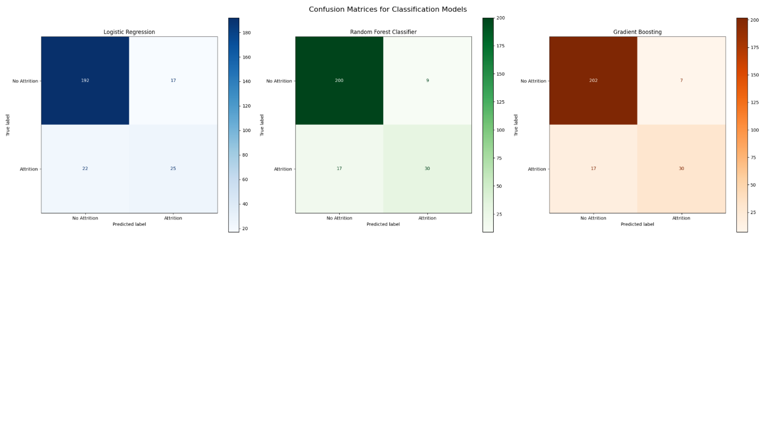
The Gradient Boosting model has a better prediction for True Positives and True Negatives when compared to the other models

Slide 24
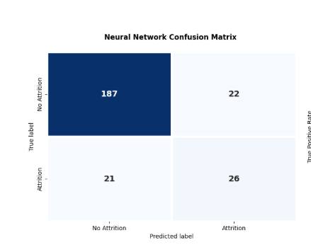
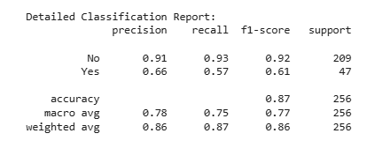
The models had 187 instances of True “No Attrition” and 26 instances of True “Attritions”
Notes:
The NN model correctly predicted 187 instances as True Positives and 26 instances

Slide 25
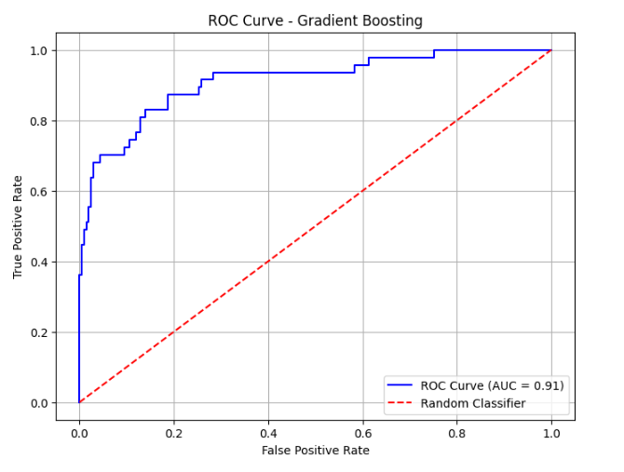
True Positive Rate – the fraction of all employees who left that the model correctly identified
False Positive – the fraction of all employees who stayed that the model wrongly flagged with ‘Yes’ attrition
At AUC = 0.91, the model is able to correctly flag those at risk of leaving 91% of the time
It can achieve a 88% True positive rate while maintaining the false positive at 15%
Notes:
The ROC-(Receiver Operating Characteristic) and AUC – (Area Under the Curve)
0-0.45: the model does not predict any leavers
Steep climb : 88% of the leavers are caught, 15% of those who stay are falsely flagged
Near the elbow: 94% of those who leave are flagged, 25% false flags
Flat: 97%, 60%

Slide 26
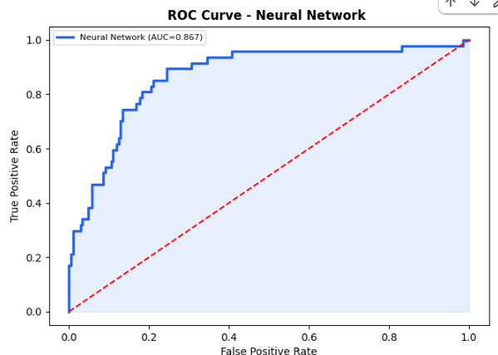
True Positive Rate – the fraction of all employees who left that the model correctly identified
False Positive – the fraction of all employees who stayed that the model wrongly flagged with ‘Yes’ attrition
At AUC = 0.8671, the model is able to correctly flag those at risk of leaving 86.71% of the time
It can achieve a 70% True positive rate while maintaining the false positive at 20%
Notes:
Both models significantly outperform random chance – the red line

Slide 27
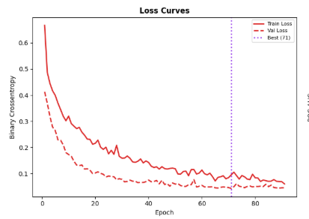
Neural network Metrics
The model is reliable as the error is dropping consistently
Notes:
The graph shows how precision and recall shifts as the model predicts that an employee will leave.
At low threshold, the model predicts many False Positives
Many False negatives after 0.5
Good loss curve

Slide 28
Comparative study of the Two models
Description of alternate dataset: Saudi Employee Attrition Dataset: 1191 columns, 35 rows
Missing values: 0
Attrition rate: 43.2%. Balanced dataset.
Source: https://data.mendeley.com/datasets/6z2hty8php/1/files/b422d0af-74b6-47b8-94ff-614e09c2382f
Gradient Boosting
Metrics | Primary Dataset | Alternate Dataset
Accuracy | 0.8867 | 0.9958
Precision | 0.7500 | 1.0000
Recall | 0.5745 | 0.9903
F1 score | 0.6505 | 0.9951
ROC- AUC | 0.9155 | 0.9951
Notes:
Features: 'ID', 'Attrition', 'Gender ', 'Age', ' Maritalstatus', ' Academic_degree ', 'Years_Experience', 'Years_experience_lastorganization', 'Sector', 'Department', 'JobTitle', 'MonthlySalary', 'Allowances', 'MedicalInsurance', 'Bonus', 'OverTime', 'Payment_Overtime', 'Rewards&Wages_Satisfaction', 'Get_ Deserved_Promotion', 'Training_programs_ During_last_three_years', 'Useful_Training_Programs', 'Business_Travel', 'Job_Support', 'Recognition', 'Emotional_Commitment', 'Job_Engagement', 'Distance_to_work', 'Work_Live_Balance', 'Physical_Stress', 'Psychological_Exhaustion', 'Job_Stability', 'Health_Issues', 'Environment_Satisfaction', 'Job_Satisfaction', 'Job_Opportunities'

Slide 29
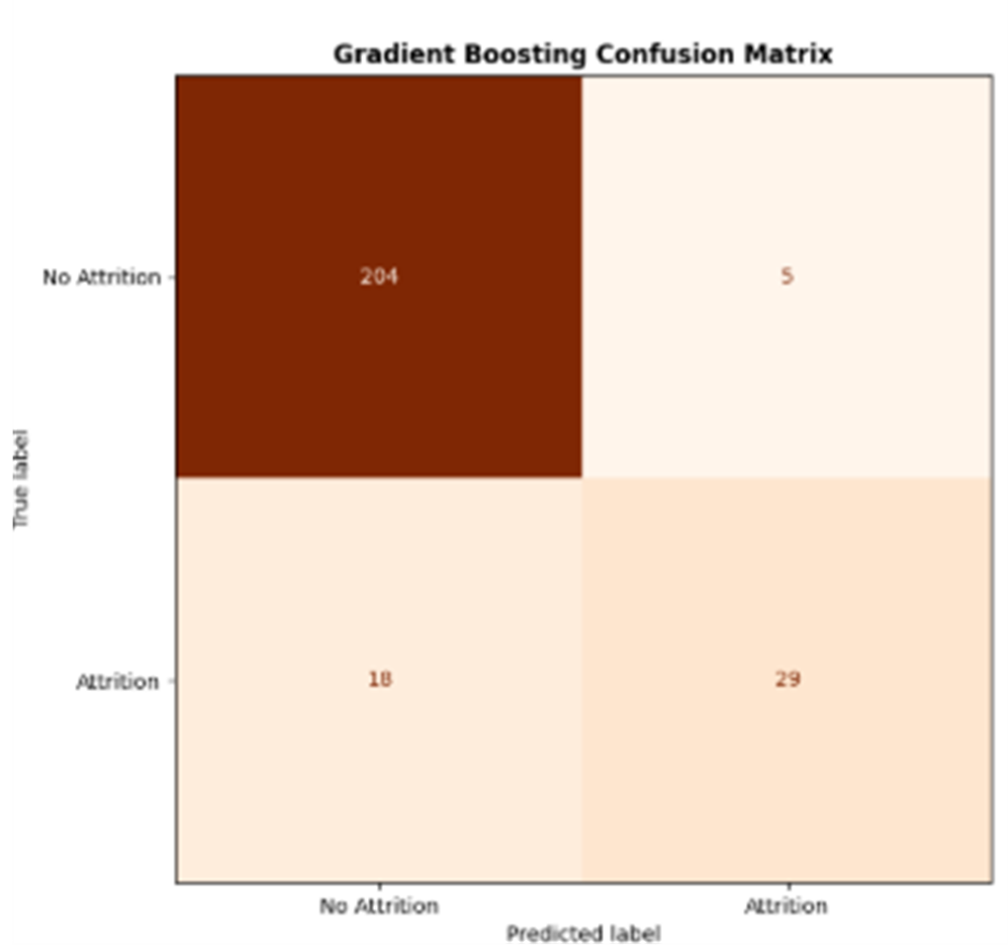
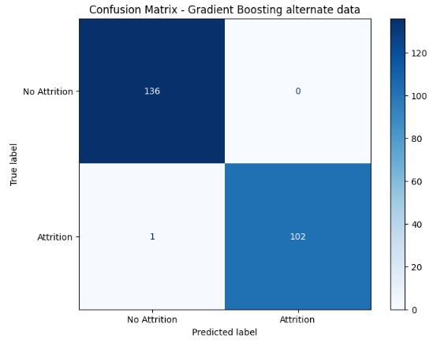
Performance of Gradient Boosting for the two datasets
Gradient boosting model performs better when working on a balanced data – alternate data

Slide 30
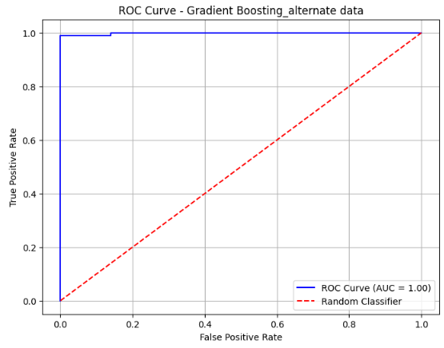
Performance of Gradient Boosting for the two datasets
The model has a strong discriminative power on the alternate dataset i.e. at 99%, it can correctly predict the employees who will leave or stay

Slide 31
Neural Network model Evaluation
Metrics | Primary Dataset | Alternate Dataset
Accuracy | 0.8672 | 0.9874
Precision | 0.6750 | 0.9902
Recall | 0.5745 | 0.9806
F1 score | 0.6207 | 0.9854
ROC- AUC | 0.8923 | 0.9965

Slide 32
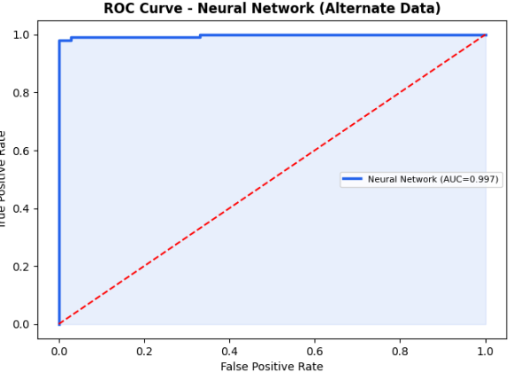
For the balanced dataset the model, can predict employees at risk of Attrition: 99.7% of the time

Slide 33
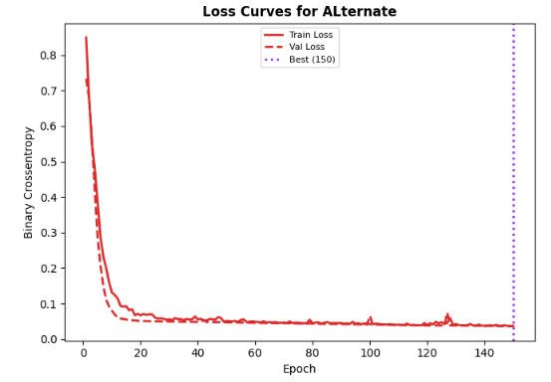
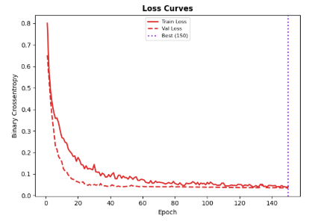
Learning Curves for the Neural Network model
The model is learning genuine patterns as the epochs increase
Notes:
How well the model is learning overtime

Slide 34
Demo interface
Gradio demo interface: https://ccd4566014d9563b86.gradio.live

Slide 35
Conclusion
The model performs better on a balanced dataset

Slide 36
Reference
Data Source: (DataCamp) https://app.datacamp.com/learn/courses/case-study-hr-analytics-in-tableau
Alternate dataset:
Saudi Employee Attrition Dataset: https://data.mendeley.com/datasets/6z2hty8php/1/files/b422d0af-74b6-47b8-94ff-614e09c2382f
Github Repo: https://github.com/pheebnabun-art/Final-project_Data-Science-and-Machine-Learning-course

Slide 37
Thank you

